Slide 1

Self Introduction
Customer Service Job Interview
Presenter: Chia-Wei Li
Date: 2022/03/18

Slide 2
Outline
Master’s Degree Thesis
Internships
Employment
Achievement
Profile
Hobbies

Slide 3

Profile
Profile
Education
MSc in Mechanical Engineering (National Chung Cheng University July 2016-Aug. 2018)
Research (Study on the Effect of Chip Heat on the Heat Transfer between the Shaft and the Nut of a Ball Screw Drive System)
An project of industry-academia cooperation with HIWIN.
Has a great knowledge of ball screw drive system.
Elevate the positioning accuracy of ball screw drive system.
BSc in Biomechatronics Engineering (National Chiayi University Sep. 2012-July 2016)
Master’s Degree Thesis
Employment Achievement
Work Experience
Nano etch Equipment Experience (Aug. 2019 – Dec. 2021)
Responsibilities include:
Using troubleshooting skills to tackle various mechanical equipment issues
Tool relocation (system setup & vendor management and coordination control schedule ).
Manage Equipment constant system to make sure tool’s health.
Analyze tool’s available time why it descent or increase and find the root cause why tool’s long down.
Inventory management of RF-system, FCS ,Vacuum system… etc.
Internships
Hobbies
Awards & License
Deputy Manager Award of Good management on Alarm system at TSMC.
Level C technician for electromechanical license.

Slide 4
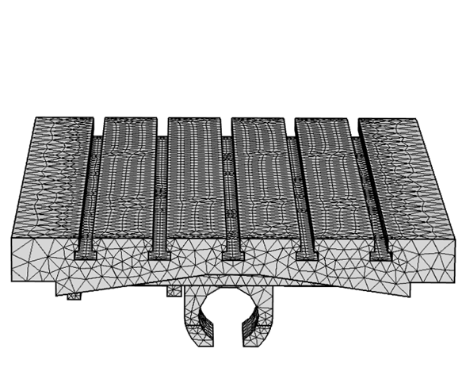
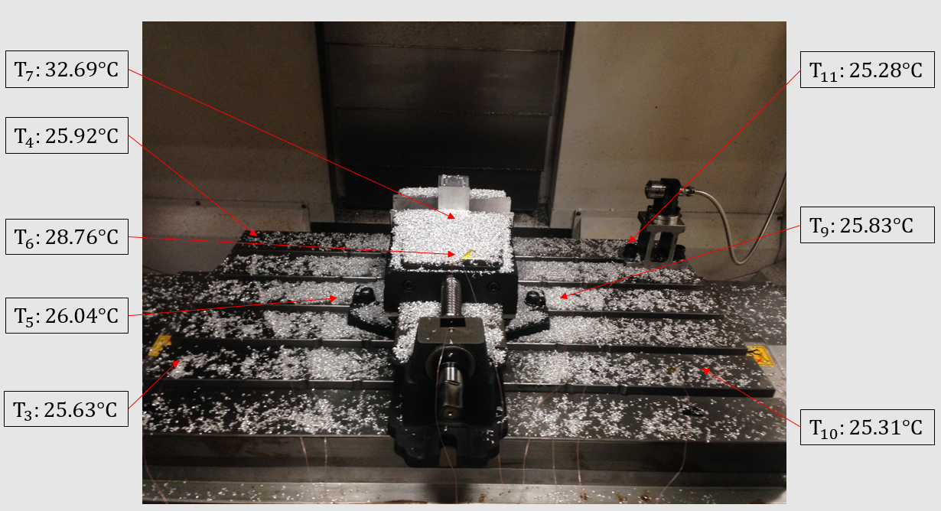
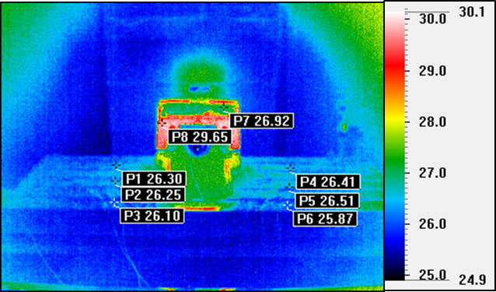
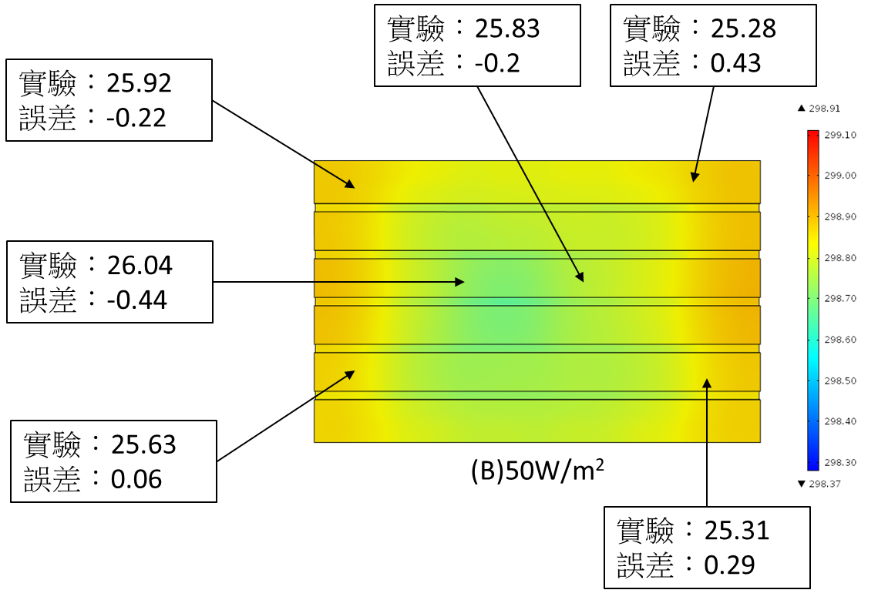
Master’s Degree Thesis
Problem
How to predict the chip heat impact on the positioning accuracy of ball screw drive system?
Chip heat
Design a experiment that use cutting tool to cut metal and measure worktable’s temperature by thermocouples.
Experiment compare with Simulation
Compare two result and establish the model can predict the chip heat precisely.
Profile
Master’s Degree Thesis
Employment Achievement
Internships
After cutting metal and measure by thermocouples.
Establish model to simulate the heat of cutting metal.
Hobbies
Using thermal imaging camera measure worktable’s temperature.
This model can predict chip heat precisely.

Slide 5
Employment Achievement
Profile
Matcher retrofit by replacing parts (finished)
Discuss with vendor and find the broken issue.
Discuss with process engineer to make sure its retrofit will not impact product.
Extend matcher’s life from 1 year to 2 years.
Master’s Degree Thesis
Manage Alarm system
Redefine the alarm setting and set proper action at particular alarm.
Decrease 20% unnecessary alarm message.
Gain more tool’s available time and gain more capacity of wafer per hour.
Employment Achievement
Manage Equipment constant system
Tighten the spec of equipment constant and make sure tool’s health.
Evaluate spec’s reasonable and set the proper spec on tool.
Protect the quality of products and defense the situation of low yield.
Internships
Hobbies

Slide 6
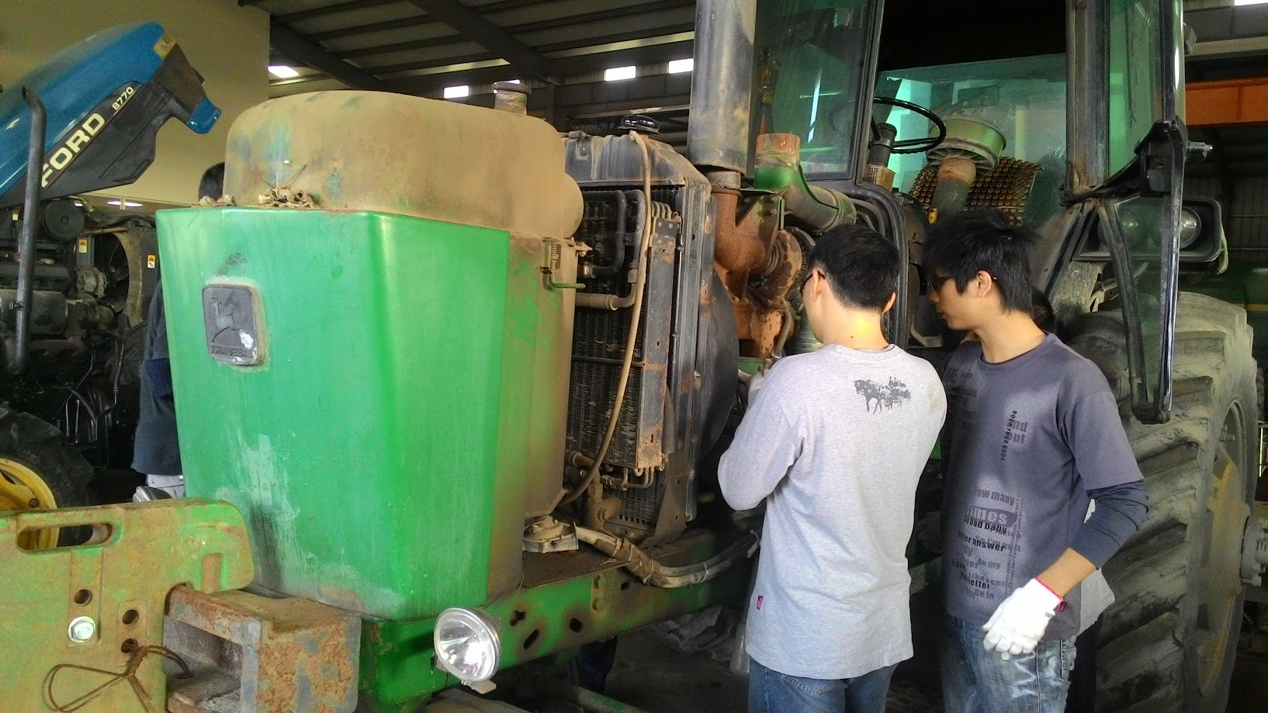
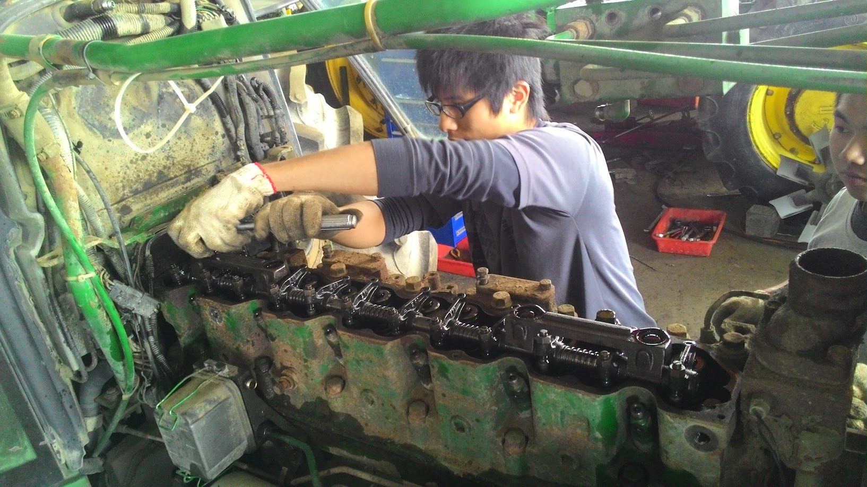
Internships
Profile
Work as an Intern at 強鹿實業股份有限公司 (Dec. 2015~ Dec. 2015)
Learn a lot about the structure of the agricultural machine.
Learn the important of cooperation.
Using suitable tools in proper way is very important.
Think twice before you take action.
Master’s Degree Thesis
Employment Achievement
Internships
Hobbies

Slide 7
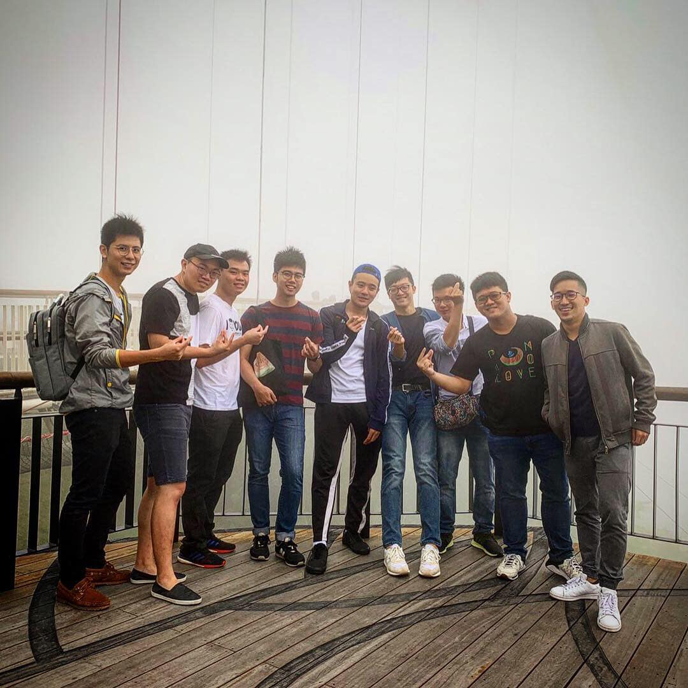
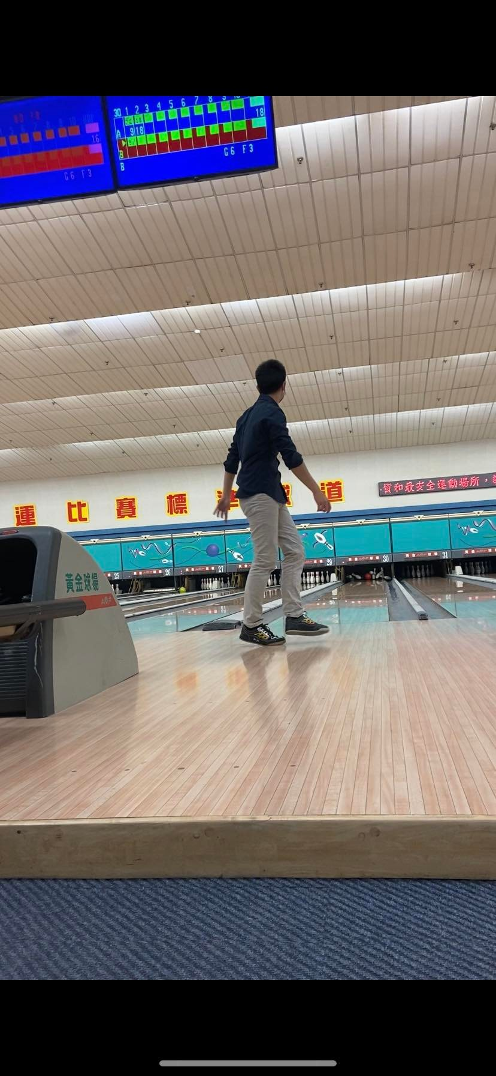
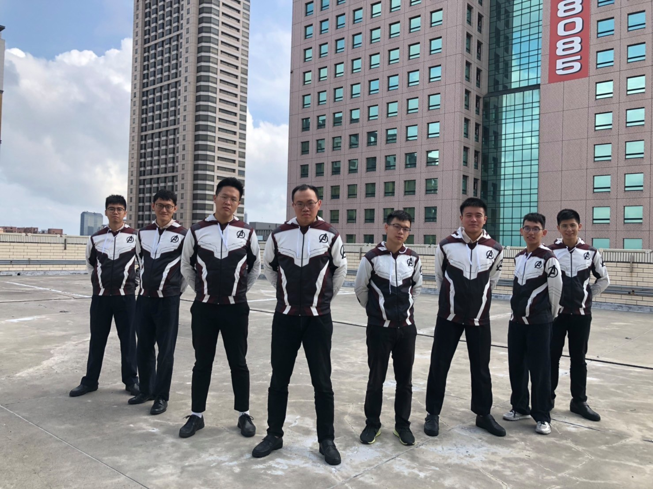
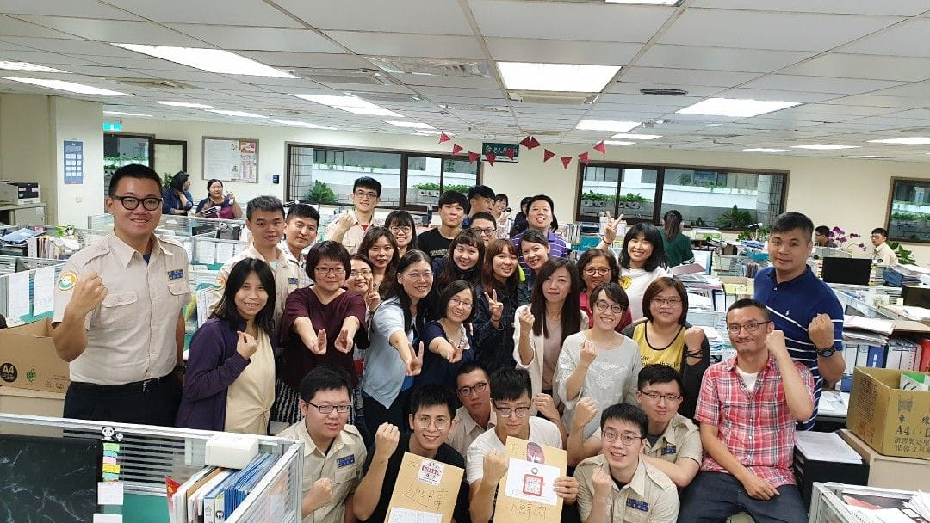
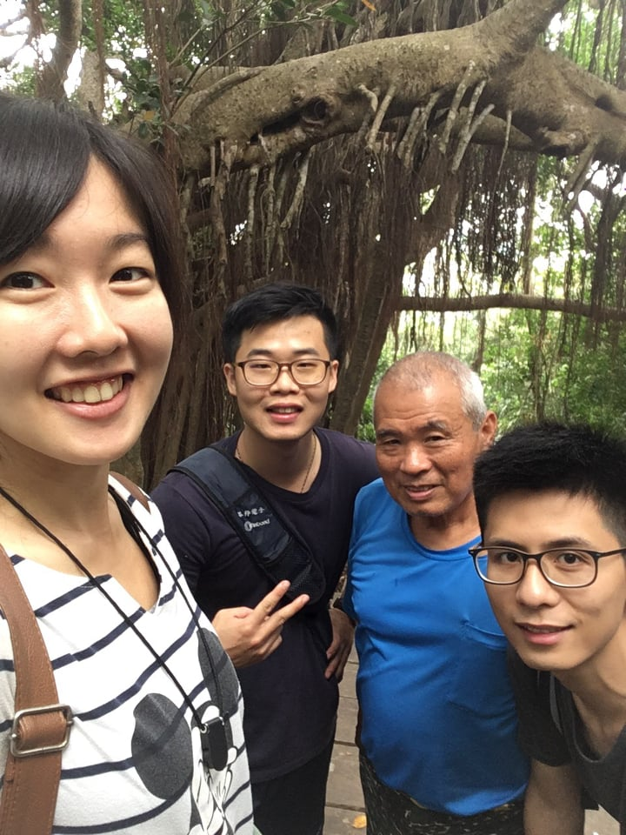
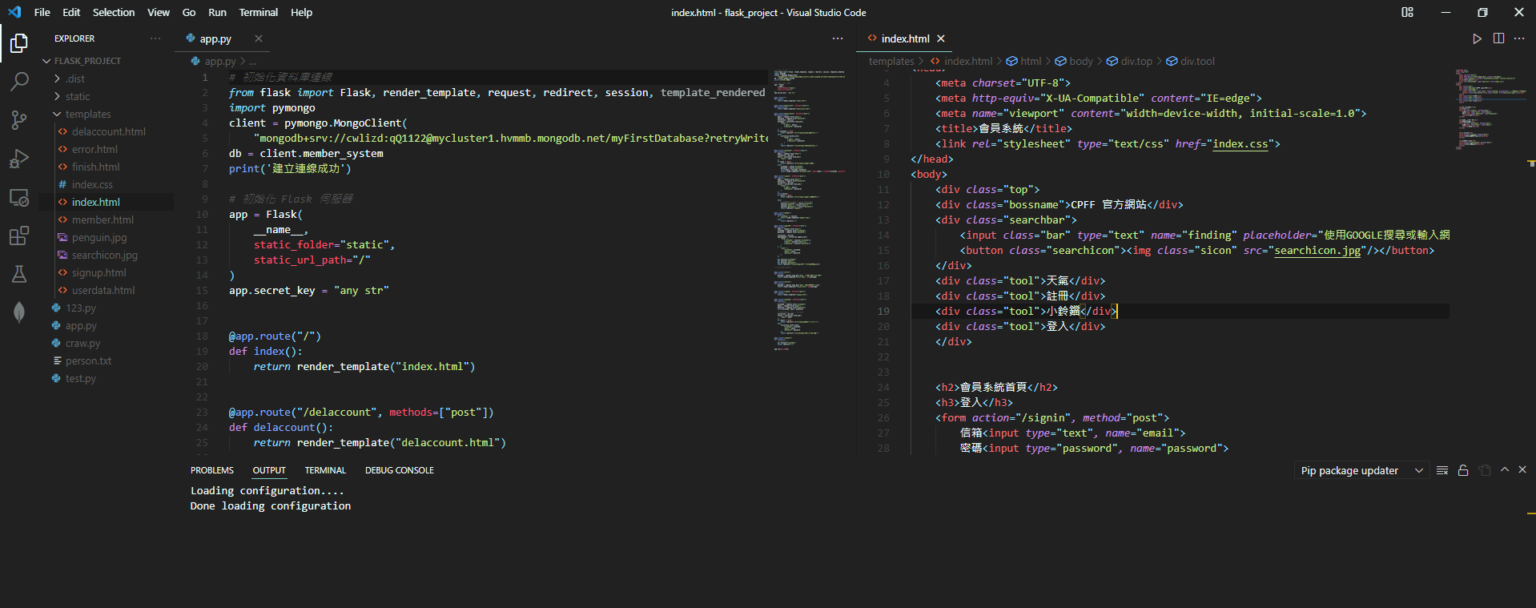
Hobbies
Profile
Master’s Degree Thesis
Employment Achievement
Internships
Hobbies

Slide 8

Thank you for your time and attention.

